Slide 1

COVID-19 in the US (EDA)
Plamen Dzhelepov

Slide 2
Overview & Motivation
COVID-19 is a deadly virus
It is on everyone’s mind currently (Apr 2020)
We are all trying to figure out as much as possible
Notes:
the likes of which we haven’t seen in the past 100 years and it affects everyone in the US and internationally
We are all affected by it, especially our daily lives, we are not allowed to socialize and must work from home. And we are all paying attention to it and wondering when there will be a vaccine and whether and when we will return to our normal lives.
In terms of gathering data, analyzing it, in order to take measures and prevent the further spread
#Decided to explore that in my hypothesis testing in terms of cases and deaths (men vs women) and whether there is some statistic significance

Slide 3
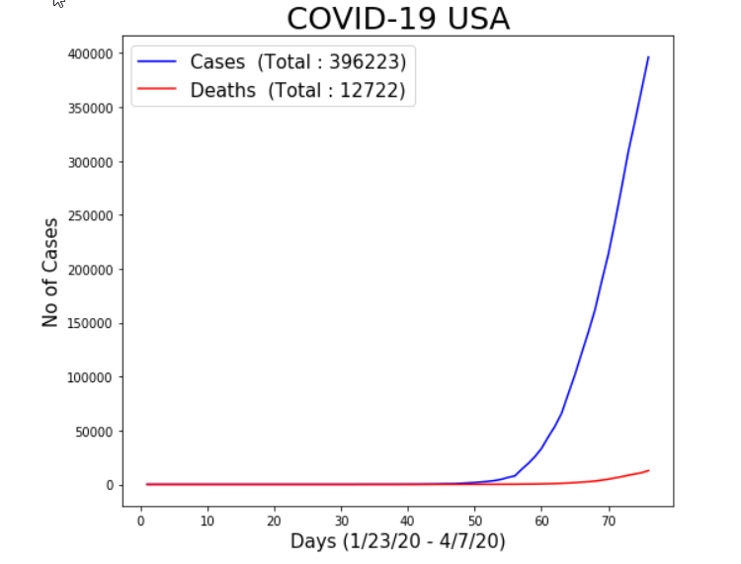
Data Exploration
Source: https://github.com/CSSEGISandData/COVID-19; Data Repository by Johns Hopkins CSSE
Notes:
Left side is time-series data for the US as a whole, 3254 rows and 100 columns

Slide 4
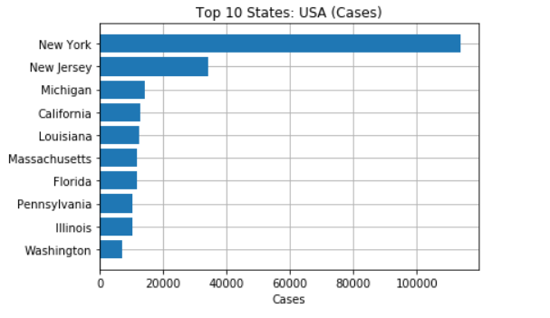
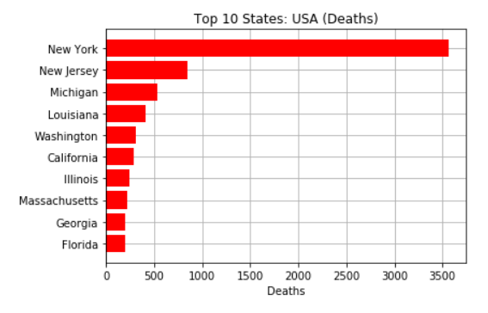
Data Exploration
Source: https://github.com/CSSEGISandData/COVID-19; Data Repository by Johns Hopkins CSSE
Notes:
Snapshot data up to that day, for example 04/08/2020 – US States & Counties; Cases & Deaths. 2680 rows and 10 columns.

Slide 5
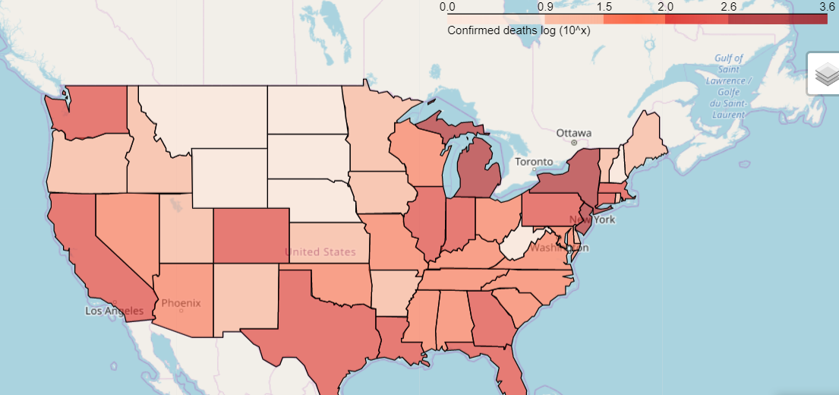
Data Exploration
Number of deaths by COVID-19 by state (choropleth map)
Source: https://github.com/CSSEGISandData/COVID-19; Data Repository by Johns Hopkins CSSE
Notes:
Same as last slide

Slide 6
Hypothesis testing
Hypothesis tests – one for cases and one for death counts (male vs women). General hypotheses for both tests:
H0: p_males = p_females, H1: p_males > p_females
One sided t-test (N.B. Not a simple random sample)
Cases:
The difference of means between the populations is low and p=.10, which is bigger than .05.
We fail to reject the null that there is no difference between men and women in terms of cases.
Deaths:
The difference of means between the populations is high. p=3.07*10⁻⁷, which is lower than .05.
We reject the null that there is no difference between men and women in terms of death counts.
Conclusions:
There is a statistically significant difference between men and women in terms of probability of death because of the virus. And no statistical difference in terms of probability of contracting the virus.
Source: http://globalhealth5050.org/covid19/, aggregate data of all countries that report gender differences in COVID-19 related cases & deaths

Slide 7
Conclusion
There are several hotspots in the US in terms of cases and deaths concentrated in the Northeast
But the virus is quickly spreading, and other hotspots are forming
Future directions:
As more data comes in about COVID-19, I can investigate income levels, BCG vaccine, density and their relationship with the number of cases in each state/county/country.
Link to Github: https://github.com/plamengj/COVID-19-in-the-US-EDA

